Slide 1



FIBONACCI
SEQUENCE
Group 8
1

Slide 2
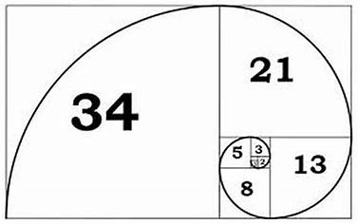
Introduction
THE FIBONACCI SEQUENCE IS A SERIES OF NUMBERS WHERE EACH NUMBER IS THE SUM OF THE TWO PRECEDING ONES.
MATHEMATICALLY:
F(n) = F(n-1) + F(n-2) with initial
values F(0) =0 and F(1) =1
The sequence begins: 0, 1, 1, 2, 3, 5, 8, 13, etc.
2

Slide 3
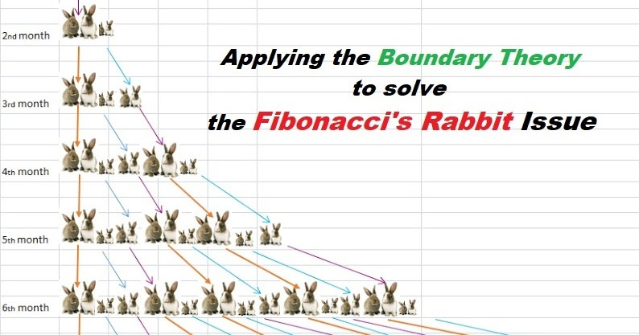
ORIGINS AND HISTORICAL BACKGROUND
FIBONACCI AND THE RABBIT PROBLEM
The sequence is named after Leonardo of Pisa, or Fibonacci, who introduced it in his 1202 book Liber Abaci. He used it to model rabbit population growth, leading to the discovery of
a recurring pattern in nature.
Since its discovery, the Fibonacci sequence has fascinated mathematicians and found relevance across fields like biology, art, finance, and computing.
SIGNIFICANCE IN MATHEMATICS
3

Slide 4
Notable Properties and Patterns in Fibonacci Numbers
PROPERTIES OF DIVISIBILITY
EVERY THIRD FIBONACCI NUMBER IS EVEN, AND EVERY FOURTH NUMBER IS A MULTIPLE OF THREE, HIGHLIGHTING THE INHERENT STRUCTURE WITHIN THE SEQUENCE.
SUM OF FIBONACCI NUMBERS
THE SUM OF THE FIRST N FIBONACCI NUMBERS IS EQUAL TO THE (N + 2)TH FIBONACCI NUMBER MINUS 1.
4

Slide 5
MATHEMATICAL REPRESENTATION
RECURSIVE FORMULA
THE FIBONACCI SEQUENCE IS OFTEN DEFINED RECURSIVELY:
F(n) = F(n-1) + F(n-2)
CLOSED-FORM SOLUTION (BINET'S FORMULA)
A NON-RECURSIVE FORMULA KNOWN AS BINET'S FORMULA APPROXIMATES THE NTH FIBONACCI NUMBER:
F(N) = (Фⁿ-(1-Фⁿ))/√5
WHERE Ø (PHI) REPRESENTS THE GOLDEN RATIO, APPROXIMATELY 1.618.
5

Slide 6
CASES
BASE CASE: F(0)=0,F(1)=1
RECURSIVE CASE: F(N)=F(N-1)+F(N-2)
6

Slide 7
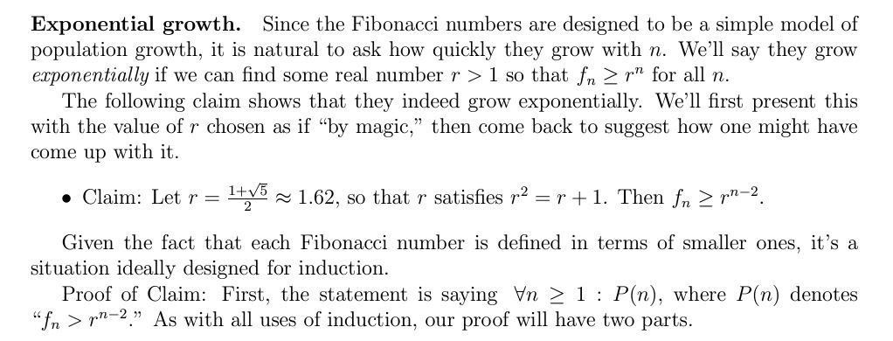
Proving By Induction:
7

Slide 8
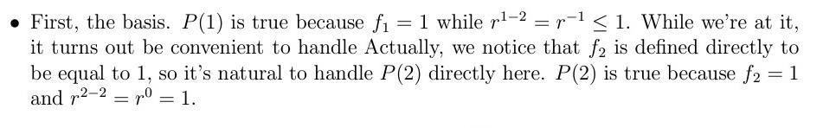
Proving By Induction:
STEP 1: BASE CASES
8

Slide 9
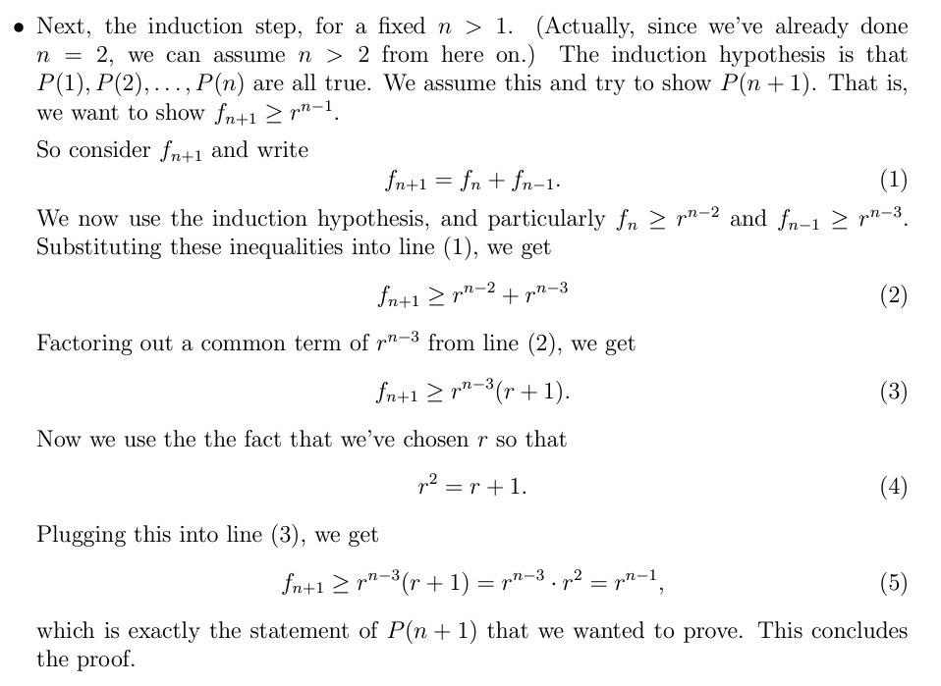
Proving By Induction:
STEP 2: INDUCTIVE STEP
9

Slide 10
An Exact Formula for the Fibonacci Numbers
WE’LL DISCUSS SOMETHING THAT’S A LITTLE MORE COMPLICATED, BUT IT SHOWS HOW REASONING INDUCTION CAN LEAD TO SOME NON-OBVIOUS DISCOVERIES. SPECIFICALLY, WE WILL USE IT TO COME UP WITH AN EXACT FORMULA FOR THE FIBONACCI NUMBERS, WRITING FN DIRECTLY IN TERMS OF N.
10

Slide 11
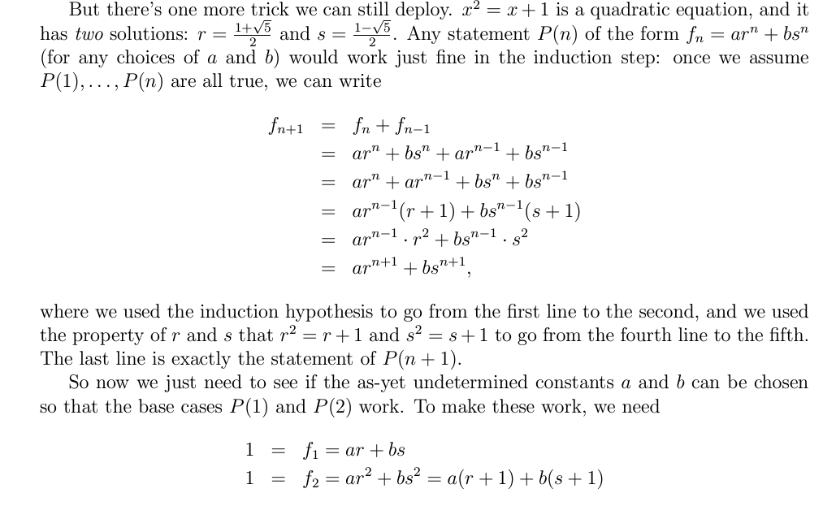
11

Slide 12
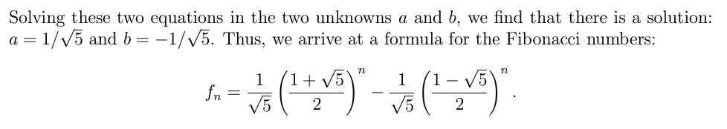
This is the Binet’s formula!
12

Slide 13
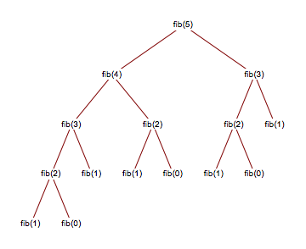
Fibonacci Binary Trees: Time Complexity and Levels
1. TIME COMPLEXITY AT EACH LEVEL:
At each level of a Fibonacci binary tree, the number of nodes doubles:
- Level 0: 1 node (root, F(n)).
- Level 1: 2 nodes (F(n-1), F(n-2)).
- Level 2: 4 nodes (F(n-2), F(n-3), F(n-3), F(n-4)).
- Level k: 2^k nodes.
Work per node is constant, so the total work at level k is proportional to the number of nodes:
Work at level k: O(2^k).
13

Slide 14
Fibonacci Binary Trees: Time Complexity and Levels
2. TOTAL TIME COMPLEXITY:
Total work is the sum of work at all levels.
The Fibonacci tree of order n has exactly F(n+2)−1 nodes.
- Since the height of the tree is n (the Fibonacci index), the total time complexity is:
Total Time Complexity = O(2^n)
14

Slide 15
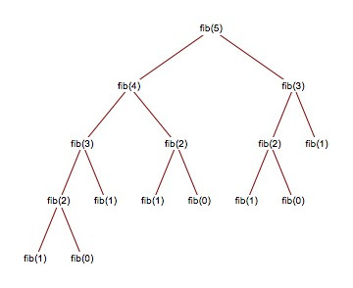
FIBONACCI BINARY TREES: TIME COMPLEXITY AND LEVELS
3. NUMBER OF LEVELS:
THE NUMBER OF LEVELS CORRESPONDS TO THE HEIGHT OF THE TREE, WHICH IS DETERMINED BY N:
ROOT IS AT LEVEL 0.
TREE HEIGHT: N.
TOTAL LEVELS: N + 1
15

Slide 16
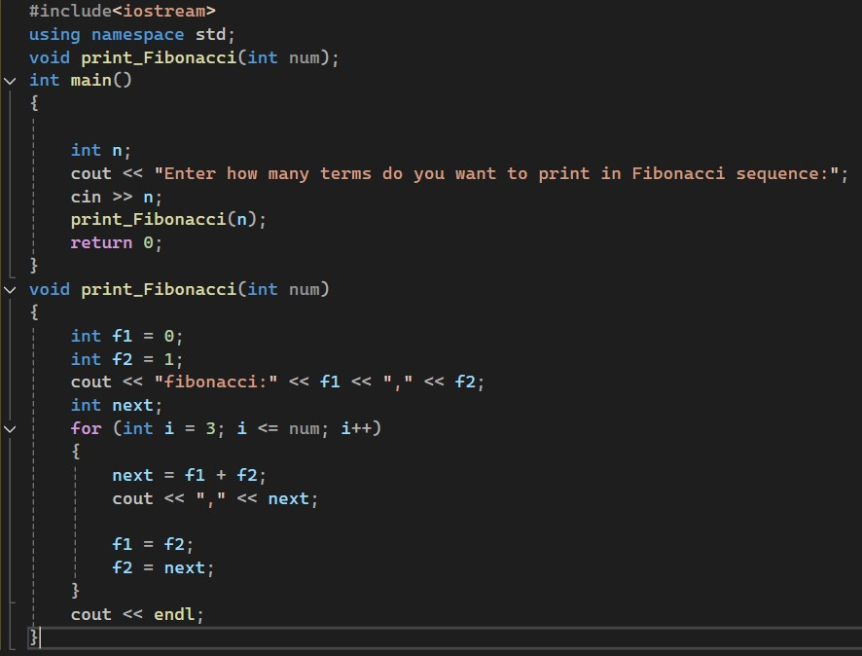
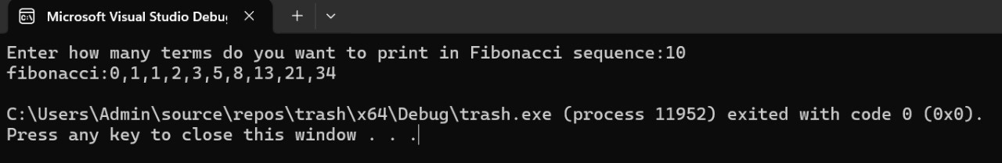
CODE
OUTPUT:
16

Slide 17
GOLDEN RATIO
THE GOLDEN RATIO () IS A MATHEMATICAL CONSTANT OFTEN ASSOCIATED WITH AESTHETICS, DEFINED AS:
Ф=(1+√5)/2=1.618
CONVERGENCE TO THE GOLDEN RATIO
AS WE MOVE FURTHER ALONG THE FIBONACCI SEQUENCE, THE RATIO BETWEEN CONSECUTIVE TERMS APPROACHES THE GOLDEN RATIO, REFLECTING A NATURALLY RECURRING PATTERN THAT APPEARS IN ART, NATURE, AND ARCHITECTURE.
17

Slide 18
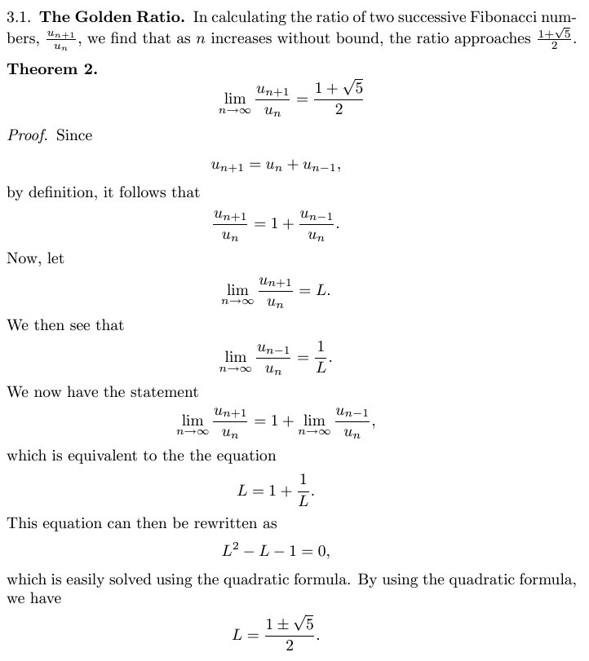
GOLDEN RATIO
18

Slide 19
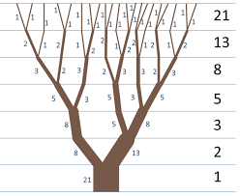
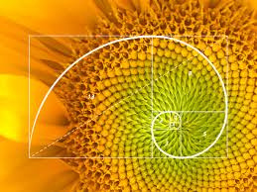
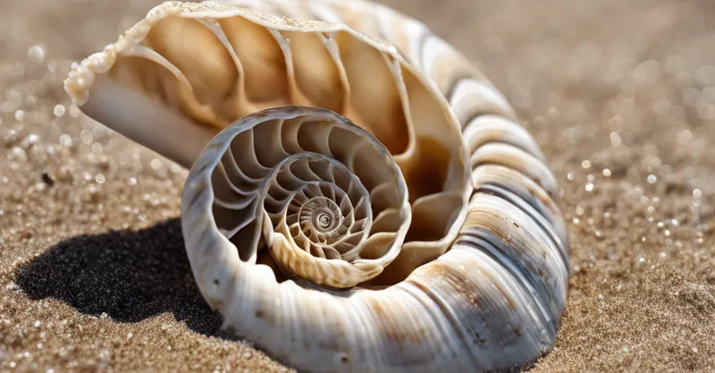
APPLICATIONS
PATTERNS IN NATURE
THE FIBONACCI SEQUENCE IS VISIBLE IN NATURAL PHENOMENA, INCLUDING THE ARRANGEMENT OF LEAVES, BRANCHING OF TREES, AND PATTERNS IN SHELLS AND FLOWERS.
19

Slide 20
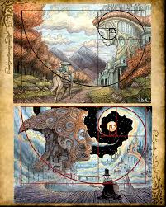

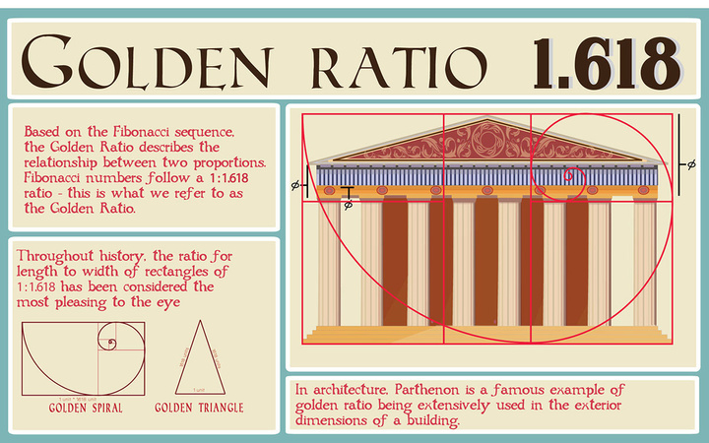
APPLICATIONS
ART AND AESTHETIC APPEAL
ARTISTS AND ARCHITECTS USE THE GOLDEN RATIO TO ACHIEVE HARMONY IN THEIR WORK. THE PARTHENON IN GREECE AND PAINTINGS BY LEONARDO DA VINCI ILLUSTRATE THE PLEASING PROPORTIONS DERIVED FROM FIBONACCI NUMBERS.
20

Slide 21
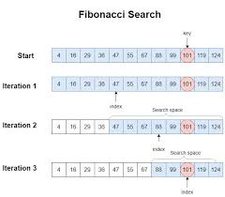
APPLICATIONS
COMPUTER SCIENCE
FIBONACCI SEARCH ALGORITHM:
THE FIBONACCI SEQUENCE IS USED IN SEARCH ALGORITHMS,
PROVIDING AN EFFICIENT METHOD FOR SEARCHING SORTED ARRAYS.
2.DYNAMIC PROGRAMMING EXAMPLE:
THE SEQUENCE OFTEN APPEARS IN DYNAMIC PROGRAMMING PROBLEMS, WHERE RECURSIVE SOLUTIONS CAN BE OPTIMIZED THROUGH MEMOIZATION, ILLUSTRATING EFFICIENT PROBLEM-SOLVING TECHNIQUES.
21

Slide 22
APPLICATIONS
FINANCIAL ANALYSIS
FIBONACCI RATIOS AND TRADING
IN TECHNICAL ANALYSIS, FIBONACCI RATIOS (SUCH AS 23.6%, 38.2%, 61.8%) ARE USED TO PREDICT POTENTIAL REVERSAL POINTS AND IDENTIFY PRICE TRENDS, MAKING THEM A VALUABLE TOOL FOR TRADERS.
22

Slide 23
APPLICATIONS
CRYPTOGRAPHY:
PSEUDORANDOM NUMBER GENERATORS:
Fibonacci sequences can seed random number generators for cryptographic applications.
2. Steganography:
Fibonacci-based encoding schemes hide data within other media
3. Network Theory:
Fibonacci numbers optimize packet routing and load balancing.
Nodes follow Fibonacci rules for failover or task reassignment.
ROUTING ALGORITHMS:
DISTRIBUTED SYSTEMS:
23

